Slide 1
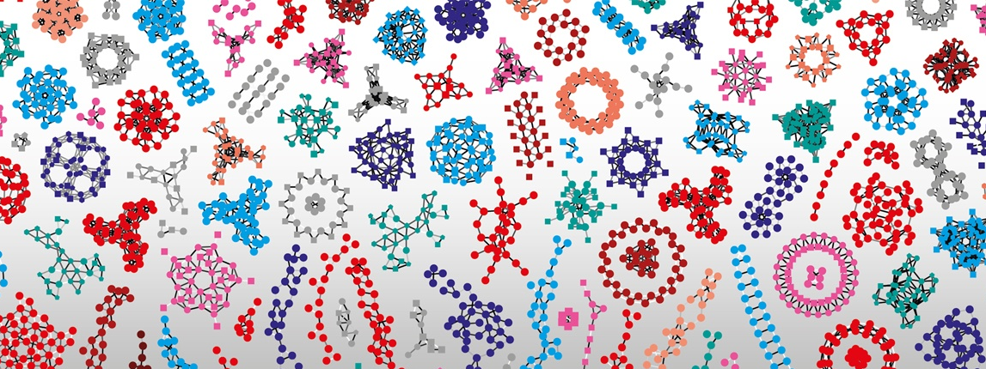

Deep learning techniques in Life sciences
Van Du Tran, Markus Müller, Wandrille Duchemin
SIB Swiss Institute of Bioinformatics
November 2025

Slide 2
Outline
Autoencoders
Convolutional neural networks
Recurrent neural networks

Slide 3
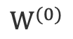
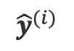
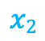
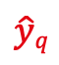
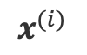
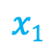
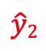
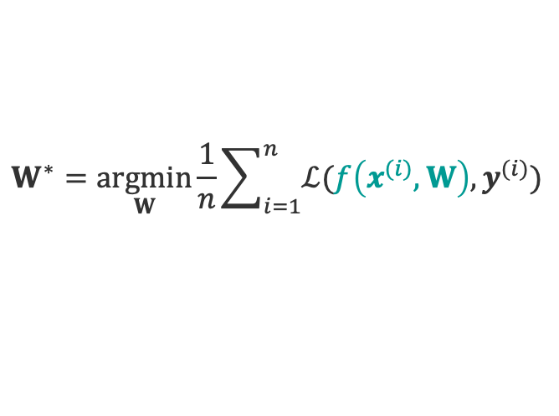
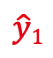
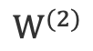

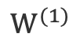

Neural Network revisited
Input
Hidden layer 1
Hidden layer 2
Output
$$x^{(i)}$$
$${\hat{y}}^{(i)}$$
$$x1$$
$$\hat{y}1$$
$$x2$$
$$\hat{y}2$$
$$\hat{y}q$$
$$xp$$
$$W$$
$$W^{(0)}$$
$$W^{(1)}$$
$$W^{(2)}$$
Activation functions on linear regressions
Loss optimization
$$W^{∗}=\underset{W}{argmin}{\frac{1}{n}\sum_{i=1}^{n}{ℒ(f\left(x^{(i)},W\right), y^{(i)})}}$$

Slide 4
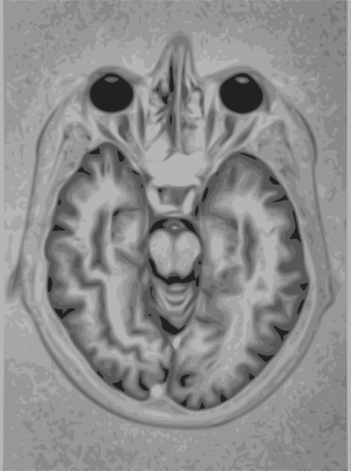
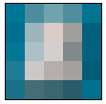
Dimensionality issue
5x5 pixels
1524 x 2048 pixels
Sparsity
Closeness
Full connectivity => curse of dimensionality!
https://commons.wikimedia.org/w/index.php?curid=1078380
https://commons.wikimedia.org/wiki/File:Brain_Mri_nevit.svg

Slide 5
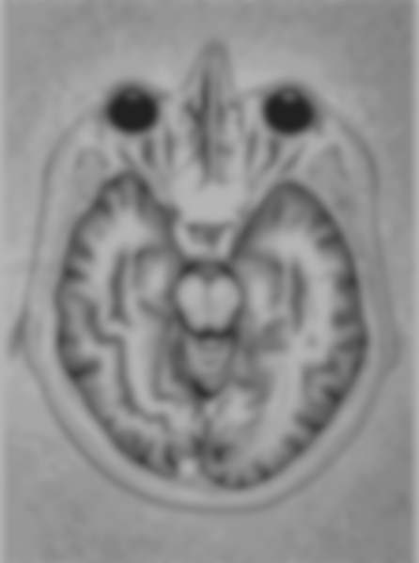
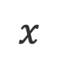
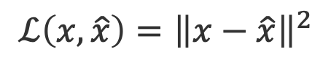

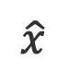
Autoencoder
Learning a lower-dimensional feature representation (compression) from unlabeled training data and a reconstruction back
Encode
Decode
Bottleneck layer
Reconstructed input
Input
Output
$$z$$
Latent space
deterministic
$$x$$
$$\hat{x}$$
$$ℒ\left(x,\hat{x}\right)={\left\|x−\hat{x}\right\|}^{2}$$

Slide 6
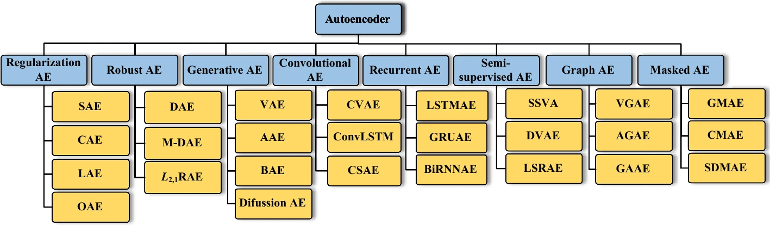
Autoencoder
Generalization of PCA: non-linear
Challenges: learn a meaningful and generalizable latent space representation
Latent dimension
Noise > Structure
Anomaly detection
Generative ability
Reconstruction-only
Berahmand et al. Artificial Intelligence Review, 2024

Slide 7
Variational autoencoder
Probabilistic twist on autoencoder: map the input into a distribution instead of a fixed vector => two vectors of means and standard deviations
Encode
standard
deviation
Decode
mean
Reconstructed input
Input
Output
$$z$$
Latent space
stochastic
$$x$$
$$\hat{x}$$
$$ℒ\left(x,\hat{x}\right)=E\left[−loglikelihood\right]+divergence loss$$

Slide 8
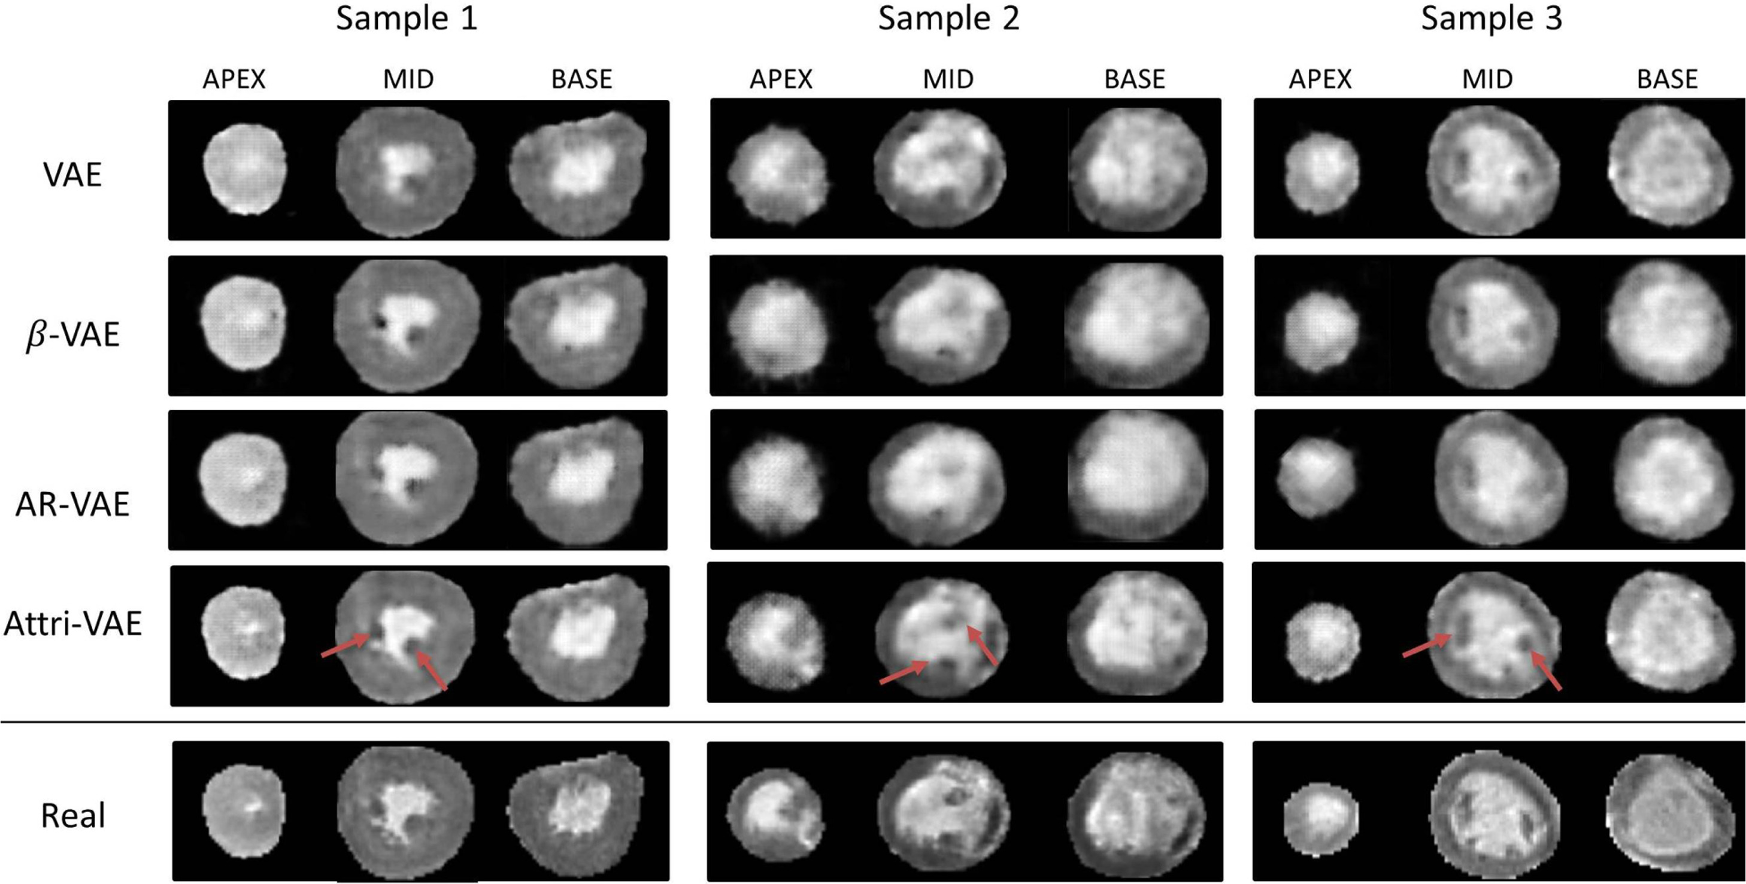
Variational autoencoder application
Generating synthetic medical images for data augmentation
Cetin et al. Computerized Medical Imaging and Graphics, 2023

Slide 9
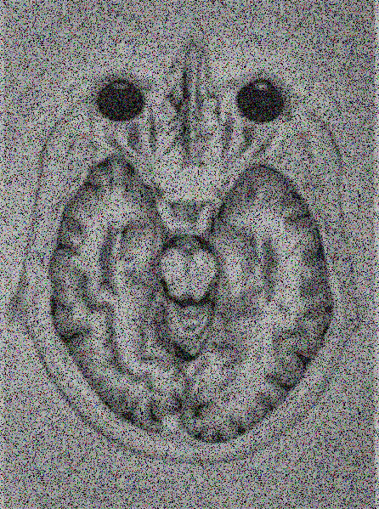
Denoising autoencoder
Learning a lower-dimensional feature representation (compression) from unlabeled training data and a reconstruction back
Encode
Decode
noise
Bottleneck layer
Reconstructed input
Input
Output
$$z$$
Latent space
deterministic
$$x$$
$$\hat{x}$$
$$ℒ\left(x,\hat{x}\right)={\left\|x−\hat{x}\right\|}^{2}$$

Slide 10
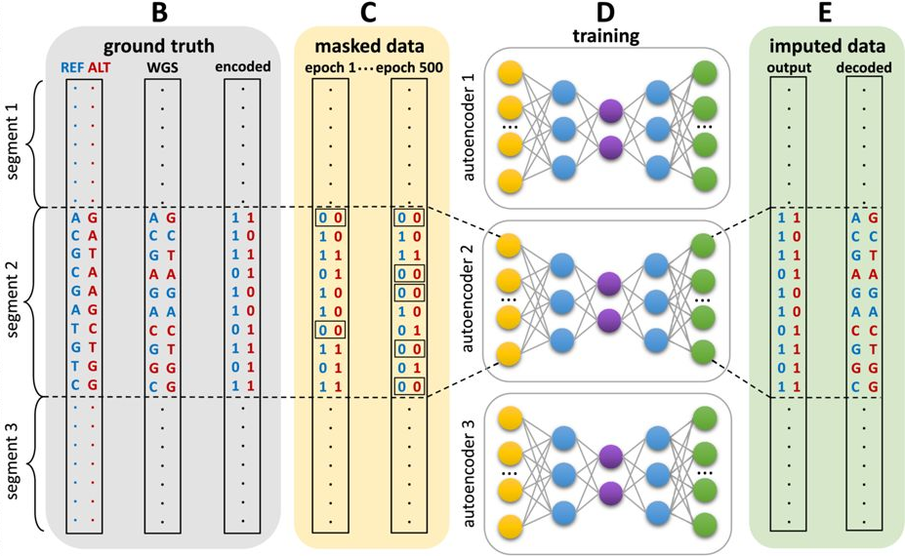
Denoising autoencoder application
Reference-free human genotype imputation for population genetics
Cetin et al. Computerized Medical Imaging and Graphics, 2023

Slide 11
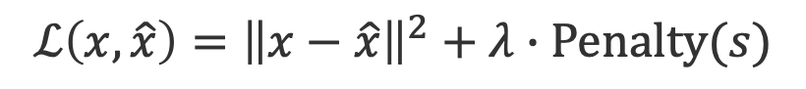
Sparse autoencoder
Learning a lower-dimensional feature representation (compression) from unlabeled training data and a reconstruction back
Encode
Decode
Bottleneck layer
Reconstructed input
Input
Output
$$z$$
Latent space
deterministic
$$x$$
$$\hat{x}$$
$$ℒ\left(x,\hat{x}\right)={\left\|x−\hat{x}\right\|}^{2}+λ∙Penalty(s)$$

Slide 12
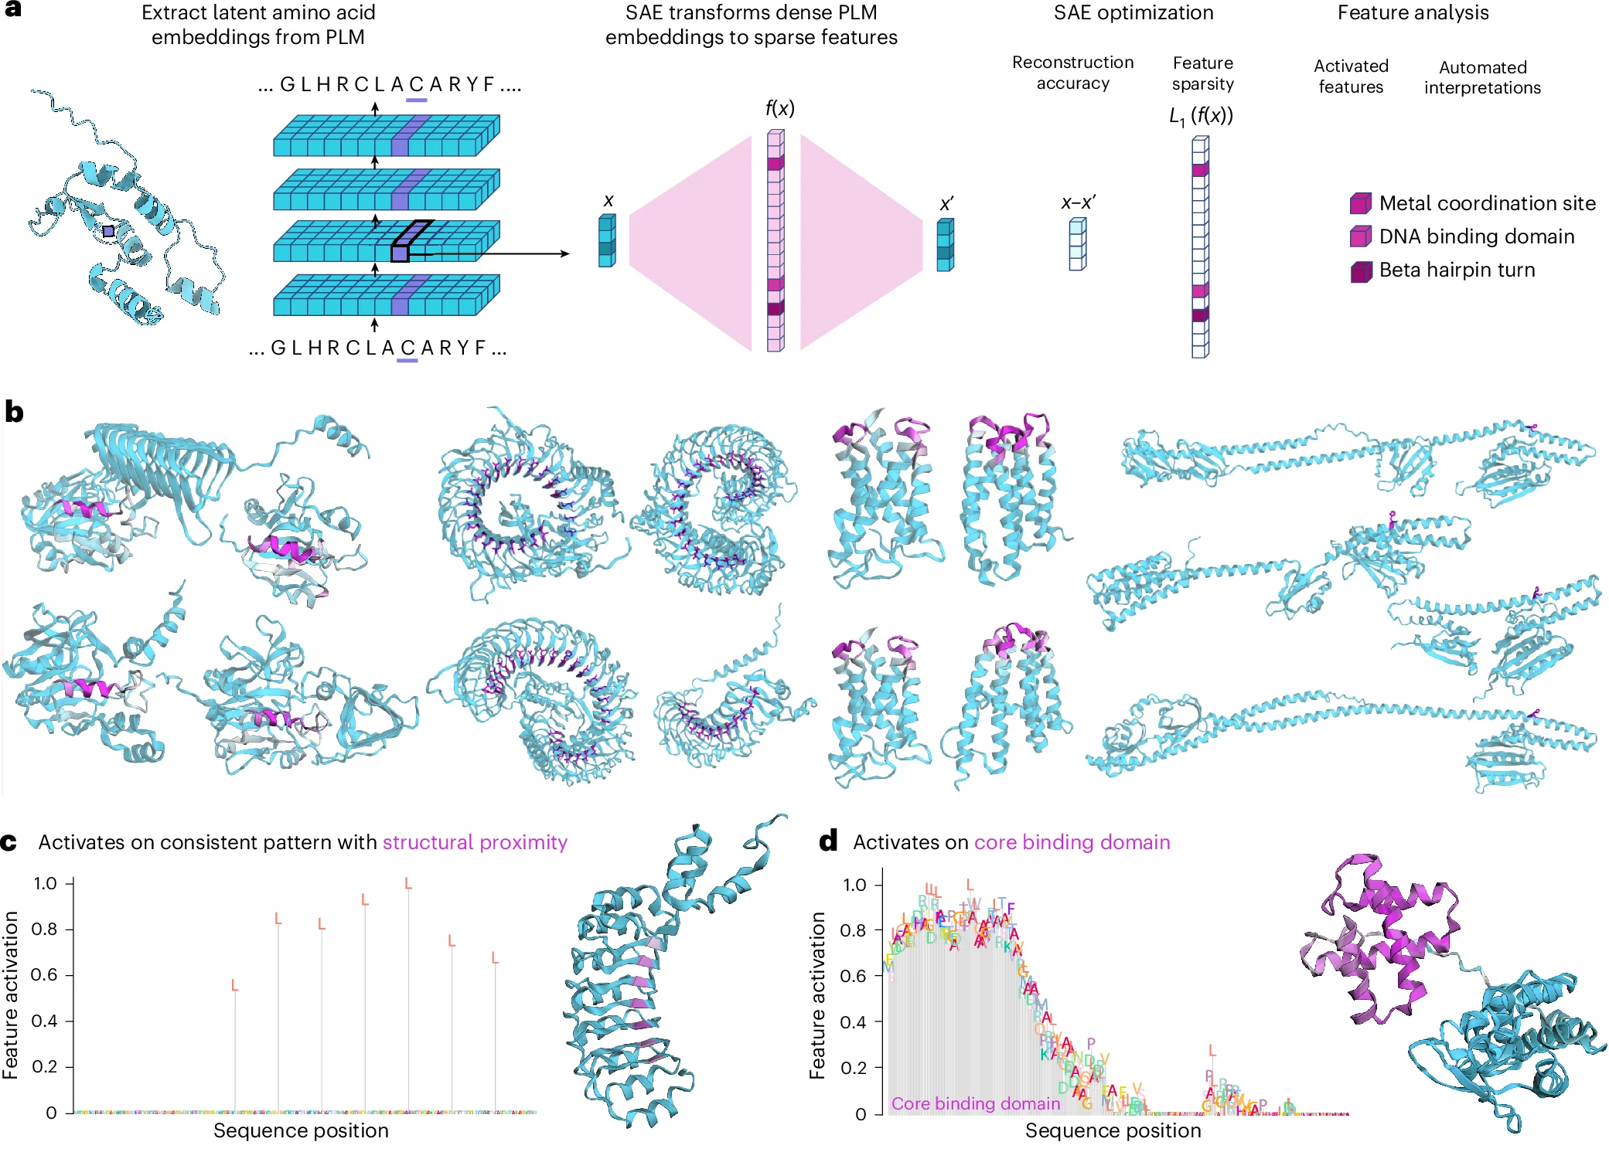
Sparse autoencoder application
Feature extraction, interpretable representation
Simon and Zou. Nature Methods, 2025

Slide 13
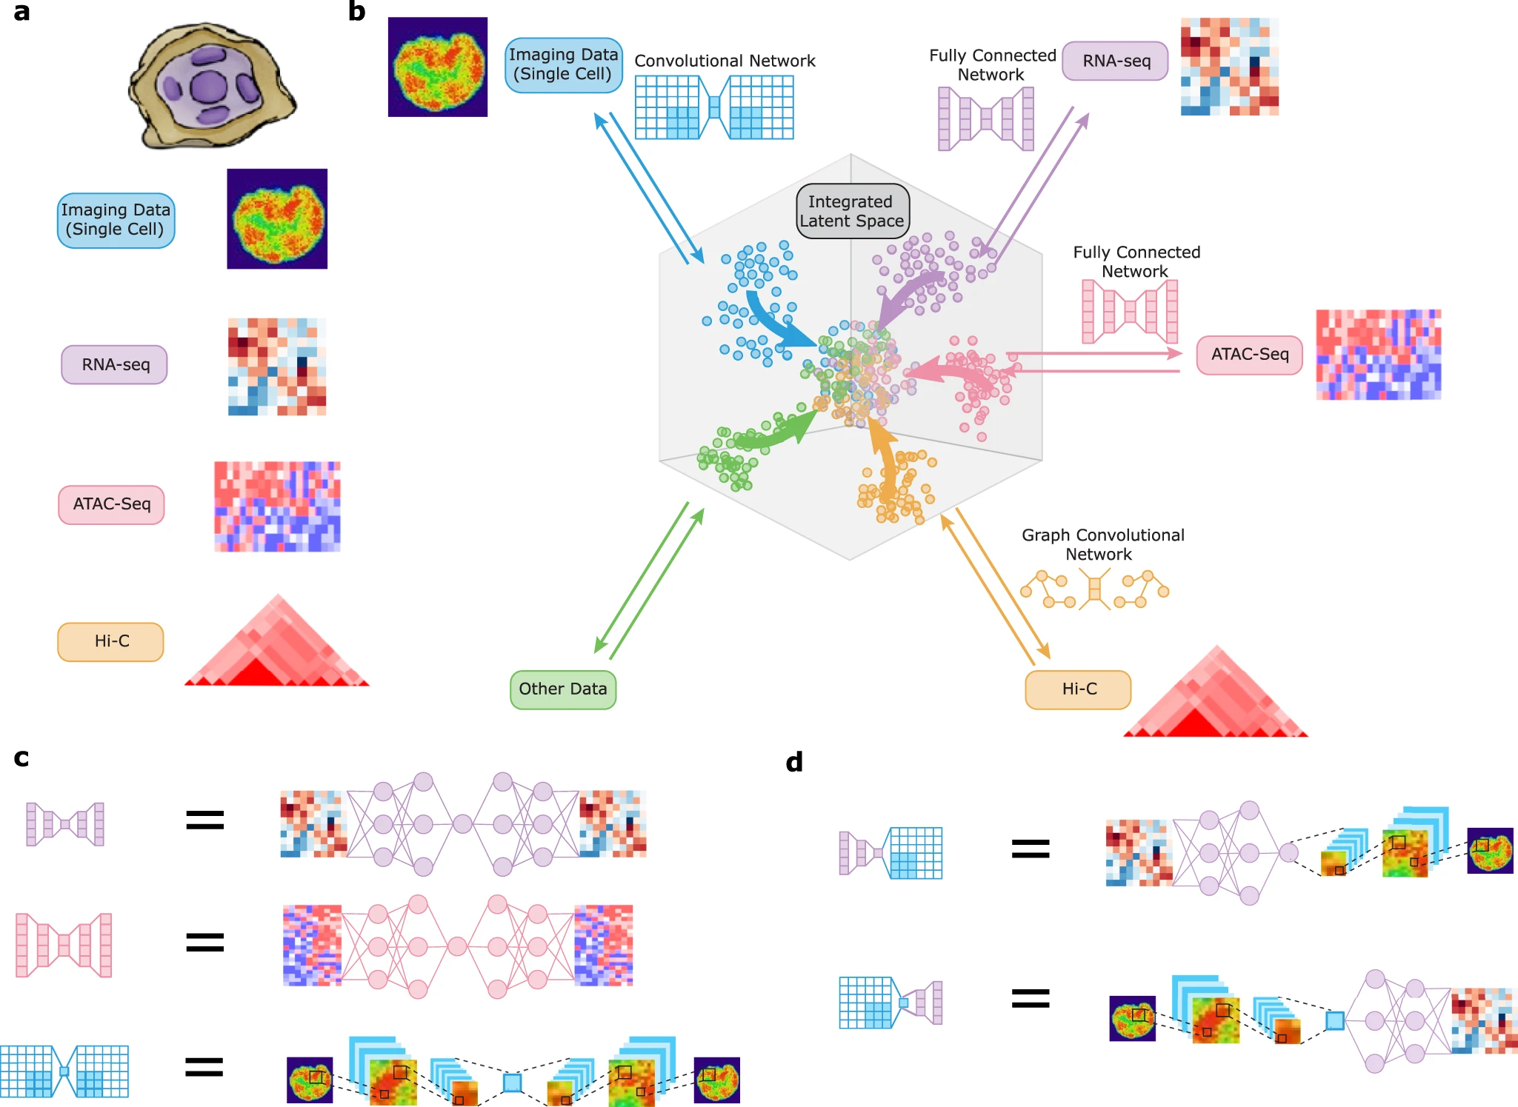
Autoencoder application
Dimensionality reduction and Data integration
Yang et al. Nature Communications, 2021

Slide 14
Outline
Autoencoders
Convolutional neural networks
Recurrent neural networks

Slide 15
Neural Network revisited
Input
Hidden layer 1
Hidden layer 2
Output
$$x^{(i)}$$
$${\hat{y}}^{(i)}$$
$$x1$$
$$\hat{y}1$$
$$x2$$
$$\hat{y}2$$
$$\hat{y}q$$
$$xp$$
$$W$$
$$W^{(0)}$$
$$W^{(1)}$$
$$W^{(2)}$$
Activation functions on linear regressions
Loss optimization
$$W^{∗}=\underset{W}{argmin}{\frac{1}{n}\sum_{i=1}^{n}{ℒ(f\left(x^{(i)},W\right), y^{(i)})}}$$

Slide 16
Convolutional Neural Network (CNN, ConvNet)
Inspired by the organization of the visual cortex
Image processing: take in image input => assign importance to features/objects => differentiate
Each neuron receives connections only from a subset of neurons in the previous layer
Spatial and temporal dependency

Slide 17
CNN: How? Convolutional layer

Slide 18
CNN: How? Convolutional layer
Input image
Filter
Feature map
1 | 0 | 0 | 0 | 1
0 | 1 | 0 | 1 | 0
0 | 0 | 1 | 0 | 0
0 | 1 | 0 | 1 | 0
1 | 0 | 0 | 0 | 1
1 | 0 | 1
0 | 1 | 0
1 | 0 | 1
Convolution operation: sum of element-wise products

Slide 19
CNN: How? Convolutional layer
Input image
Filter
Feature map
1 | 0 | 0 | 0 | 1
0 | 1 | 0 | 1 | 0
0 | 0 | 1 | 0 | 0
0 | 1 | 0 | 1 | 0
1 | 0 | 0 | 0 | 1
1 | 0 | 1
0 | 1 | 0
1 | 0 | 1
3
Convolution operation: sum of element-wise products

Slide 20
CNN: How? Convolutional layer
Input image
Filter
Feature map
1 | 0 | 0 | 0 | 1
0 | 1 | 0 | 1 | 0
0 | 0 | 1 | 0 | 0
0 | 1 | 0 | 1 | 0
1 | 0 | 0 | 0 | 1
3
1 | 0 | 1
0 | 1 | 0
1 | 0 | 1
3 | 0
Convolution operation: sum of element-wise products

Slide 21
CNN: How? Convolutional layer
Input image
Filter
Feature map
1 | 0 | 0 | 0 | 1
0 | 1 | 0 | 1 | 0
0 | 0 | 1 | 0 | 0
0 | 1 | 0 | 1 | 0
1 | 0 | 0 | 0 | 1
3 | 0 | 3
1 | 0 | 1
0 | 1 | 0
1 | 0 | 1
3 | 0
Convolution operation: sum of element-wise products

Slide 22
CNN: How? Convolutional layer
Input image
Filter
Feature map
1 | 0 | 0 | 0 | 1
0 | 1 | 0 | 1 | 0
0 | 0 | 1 | 0 | 0
0 | 1 | 0 | 1 | 0
1 | 0 | 0 | 0 | 1
3 | 0 | 3
0
1 | 0 | 1
0 | 1 | 0
1 | 0 | 1
3 | 0 | 3
Convolution operation: sum of element-wise products

Slide 23
CNN: How? Convolutional layer
Input image
Filter
Feature map
1 | 0 | 0 | 0 | 1
0 | 1 | 0 | 1 | 0
0 | 0 | 1 | 0 | 0
0 | 1 | 0 | 1 | 0
1 | 0 | 0 | 0 | 1
3 | 0 | 3
0
1 | 0 | 1
0 | 1 | 0
1 | 0 | 1
3 | 0 | 3
0 | 5
Convolution operation: sum of element-wise products

Slide 24
CNN: How? Convolutional layer
Input image
Filter
Feature map
1 | 0 | 0 | 0 | 1
0 | 1 | 0 | 1 | 0
0 | 0 | 1 | 0 | 0
0 | 1 | 0 | 1 | 0
1 | 0 | 0 | 0 | 1
3 | 0 | 3
0 | 5 | 0
1 | 0 | 1
0 | 1 | 0
1 | 0 | 1
3 | 0 | 3
0 | 5
Convolution operation: sum of element-wise products

Slide 25
CNN: How? Convolutional layer
Input image
Filter
Feature map
1 | 0 | 0 | 0 | 1
0 | 1 | 0 | 1 | 0
0 | 0 | 1 | 0 | 0
0 | 1 | 0 | 1 | 0
1 | 0 | 0 | 0 | 1
3 | 0 | 3
0 | 5 | 0
3
1 | 0 | 1
0 | 1 | 0
1 | 0 | 1
3 | 0 | 3
0 | 5 | 0
Convolution operation: sum of element-wise products

Slide 26
CNN: How? Convolutional layer
Input image
Filter
Feature map
1 | 0 | 0 | 0 | 1
0 | 1 | 0 | 1 | 0
0 | 0 | 1 | 0 | 0
0 | 1 | 0 | 1 | 0
1 | 0 | 0 | 0 | 1
3 | 0 | 3
0 | 5 | 0
3 | 0
1 | 0 | 1
0 | 1 | 0
1 | 0 | 1
3 | 0 | 3
0 | 5 | 0
3
Convolution operation: sum of element-wise products

Slide 27
CNN: How? Convolutional layer
Input image
Filter
Feature map
1 | 0 | 0 | 0 | 1
0 | 1 | 0 | 1 | 0
0 | 0 | 1 | 0 | 0
0 | 1 | 0 | 1 | 0
1 | 0 | 0 | 0 | 1
3 | 0 | 3
0 | 5 | 0
3 | 0
1 | 0 | 1
0 | 1 | 0
1 | 0 | 1
3 | 0 | 3
0 | 5 | 0
3 | 0 | 3
Convolution operation: sum of element-wise products

Slide 28
CNN: How? Convolutional layer
Input image
Filter
Feature map
1 | 0 | 0 | 0 | 1
0 | 1 | 0 | 1 | 0
0 | 0 | 1 | 0 | 0
0 | 1 | 0 | 1 | 0
1 | 0 | 0 | 0 | 1
3 | 0 | 3
0 | 5 | 0
3 | 0
1 | 0 | 1
0 | 1 | 0
1 | 0 | 1
3 | 0 | 3
0 | 5 | 0
3 | 0 | 3
1 | 0 | 0
0 | 1 | 0
0 | 0 | 1
0 | 0 | 1
0 | 1 | 0
1 | 0 | 0
Convolutional layers:
Extract low to high-level features
Reduce spatial size
Limitation: sensitive to position of features

Slide 29
CNN: How? Pooling layer
Down sampling: lower resolution + important features
After Convolutional layer + Nonlinearity (ReLU) for each feature map
Usually 2x2 pixels with stride of 2 pixels => reduce to ¼ feature map
Max or average pooling
Invariance to local translation
4 | 2
5 | 4
1 | 3 | 1 | 0
0 | 4 | 2 | 1
5 | 3 | 0 | 2
0 | 0 | 4 | 2
max
2 | 1
2 | 2
average

Slide 30
CNN: How? Fully connected layer
Input
Pooling
Convolution
Fully connected
Convolution
Flatten
.
.
.
.
.
.
Pooling
Output

Slide 31
CNN: When?
Image recognition, video analysis, natural language processing
Life sciences:
sequence analysis (DNA, RNA sequence data),
structure prediction (imaging data),
biomedical image processing and diagnosis (imaging data),
biomolecular function prediction (microarray, sequencing data, structure properties), protein variant impact prediction
biomolecule interaction prediction and system biology (microarray, interaction data)

Slide 32
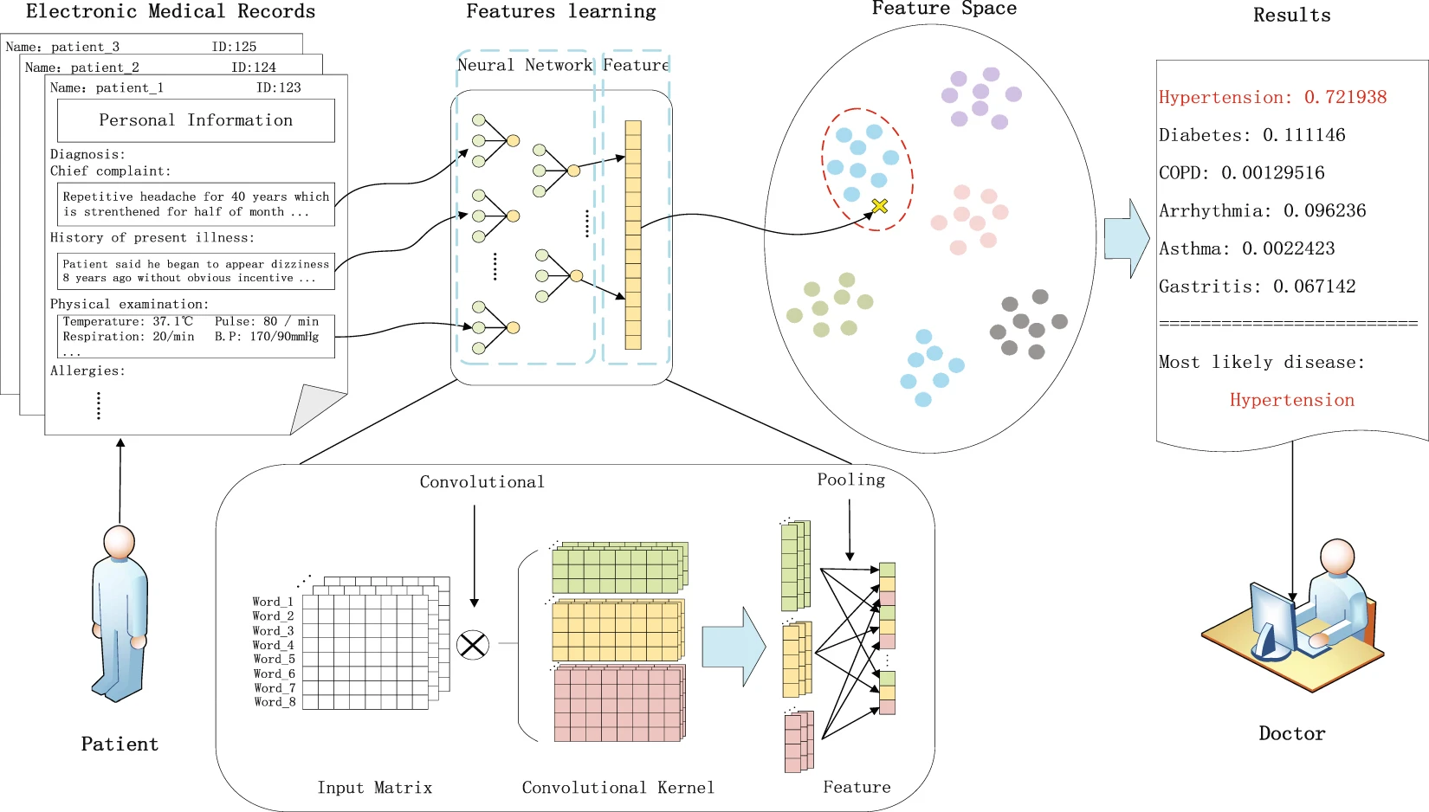
CNN application
Medical diagnostics
Yang et al. Scientific Reports, 2018

Slide 33
Outline
Autoencoders
Convolutional neural networks
Recurrent neural networks

Slide 34
Neural Network revisited
Input
Hidden layer 1
Hidden layer 2
Output
$$x^{(i)}$$
$${\hat{y}}^{(i)}$$
$$x1$$
$$\hat{y}1$$
$$x2$$
$$\hat{y}2$$
$$\hat{y}q$$
$$xp$$
$$W$$
$$W^{(0)}$$
$$W^{(1)}$$
$$W^{(2)}$$
Activation functions on linear regressions
Loss optimization
$$W^{∗}=\underset{W}{argmin}{\frac{1}{n}\sum_{i=1}^{n}{ℒ(f\left(x^{(i)},W\right), y^{(i)})}}$$

Slide 35
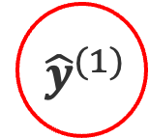
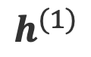
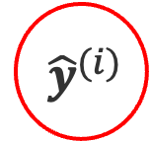
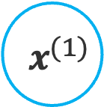
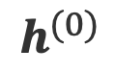
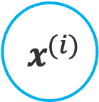
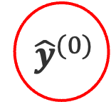
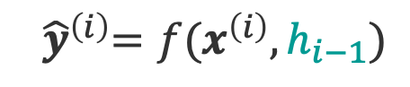
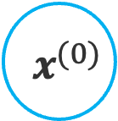

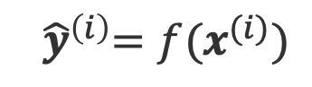
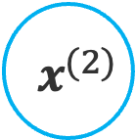
Neural Network with recurrence
$$x^{(i)}$$
$$x^{(0)}$$
$$x^{(1)}$$
$$x^{(2)}$$
Input
$$h^{(0)}$$
$$h^{(1)}$$
:
$${ \hat{y}}^{(i)}$$
$${ \hat{y}}^{(0)}$$
$${ \hat{y}}^{(1)}$$
$${ \hat{y}}^{(2)}$$
Output
$${ \hat{y}}^{\left(i\right)}=f(x^{(i)})$$
$${ \hat{y}}^{\left(i\right)}=f(x^{\left(i\right)},h_{i−1})$$
past memory

Slide 36
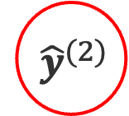
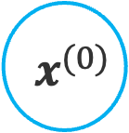
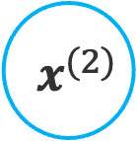
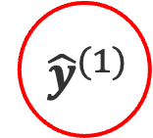
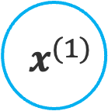
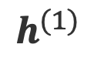
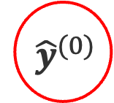
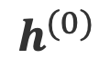
Recurrent Neural Network (RNN)
Sequential or time series data: data points depend upon previous data points
Memory: store historical information to forecast future values
$$x^{(0)}$$
$$x^{(1)}$$
$$x^{(2)}$$
$$h^{(0)}$$
$$h^{(1)}$$
$${ \hat{y}}^{(0)}$$
$${ \hat{y}}^{(1)}$$
$${ \hat{y}}^{(2)}$$

Slide 37
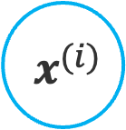
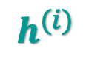
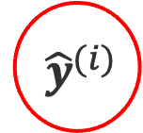
Recurrent Neural Network (RNN)
Sequential or time series data: data points depend upon previous data points
Memory: store historical information to forecast future values
$$x^{(i)}$$
Input
RNN
$$h^{(i)}$$
$${ \hat{y}}^{(i)}$$
Output

Slide 38
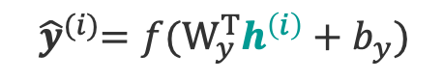
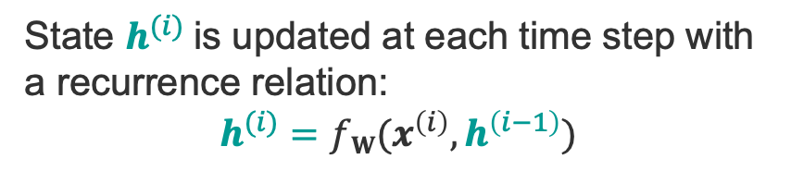




RNN: How?
$$x^{(i)}$$
Input
State $h^{(i)}$is updated at each time step with
a recurrence relation:
$$h^{(i)}=fW(x^{\left(i\right)},h^{\left(i−1\right)})$$
RNN
$$h^{(i)}$$
Same function (sigmoid, tanh, ReLU) and parameters
at every time step!
$${ \hat{y}}^{(i)}$$
Output
$$h^{(i)}=f({W_{x}^{T}x}^{\left(i\right)}+W_{h}^{T}h^{\left(i−1\right)}+b_{h})$$
$${ \hat{y}}^{(i)}={f(W}_{y}^{T}h^{\left(i\right)}+b_{y})$$
Notes:
Siri, voice search, google translate

Slide 39
Types of RNNs
One to One
One to Many
Many to One
Many to Many

Slide 40





















Back propagation through time
Calculate gradient of the loss function w.r.t. each parameter backward through the network
Adapt parameter to minimize loss
$$x^{(0)}$$
$$x^{(1)}$$
$$x^{(2)}$$
$$W_{x}$$
$$W_{x}$$
$$W_{x}$$
$$h^{(0)}$$
$$W_{h}$$
$$h^{(1)}$$
$$W_{h}$$
$$h^{(2)}$$
$$W_{y}$$
$$W_{y}$$
$$W_{y}$$
$${ \hat{y}}^{(0)}$$
$${ \hat{y}}^{(1)}$$
$${ \hat{y}}^{(2)}$$
$$L_{0}$$
$$L_{1}$$
$$L_{2}$$
$$L=\sum_{i}{L_{i}}$$

Slide 41























Gradient issues
Gradient w.r.t. $W_{h}$ involves repeated computation of gradients w.r.t. $h^{(i)},h^{(i−1)}, …,h^{(1)}$
=> many factors of $W_{h}$: $\frac{∂L}{∂W_{h}}=\sum_{k=0}^{i}{\frac{∂L_{k}}{∂W_{h}}}∝\sum_{k=0}^{i}{\frac{∂L_{k}}{∂h^{(k)}}\left(\prod_{j=2}^{k}{\frac{∂h^{(j)}}{∂h^{(j−1)}}}\right)\frac{∂h^{(1)}}{∂W_{h}}}$
$$x^{(0)}$$
$$x^{(1)}$$
$$x^{(2)}$$
1.1¹⁰⁰ ~ 1e+5
Exploding gradient:
when many values > 1
Quickly reach infinity
Gradient clipping to scale large gradients
$$W_{x}$$
$$W_{x}$$
$$W_{x}$$
$$h^{(0)}$$
$$W_{h}$$
$$h^{(1)}$$
$$W_{h}$$
$$h^{(2)}$$
$$W_{y}$$
$$W_{y}$$
$$W_{y}$$
0.9¹⁰⁰ ~ 2e-5
$${ \hat{y}}^{(0)}$$
$${ \hat{y}}^{(1)}$$
$${ \hat{y}}^{(2)}$$
Vanishing gradient:
when many values < 1
Difficult to learn long period dependencies
Activation function, weight initialization, network structure
$$L_{0}$$
$$L_{1}$$
$$L_{2}$$
$$L=\sum_{i}{L_{i}}$$

Slide 42
Adapted network structure
“I grew up in France… I speak fluently (?)”
Long Short-Term Memory Network: track information throughout many timesteps => memorize long-term dependencies
Memory cell: store information
Forget gate: what information to ignore
Input gate: which values from input to update memory state
Output gate: what to output based on input and memory state
Gate ~ neuron: activation of a weighted sum

Slide 43
RNN: When?
Language translation, speech recognition, natural language processing
Life sciences:
sequence analysis, genomic sequence evolution,
biomolecular function prediction
human-virus protein-protein interaction prediction,
biomedical ontologies,
forecast the spread of virus,
pharmaceutical development

Slide 44

RNN application
Mental health diagnostics
Rivas et al. Electronics, 2025

Slide 45
Thank you!

